Slide 1
olist e-commerce (Brazil 2016-2018) Final Project Presentation
DA-LON5 - Team 3
Ruzzel Pescozo
Charles Clarke
Basil Wahid
Silk Somalin
Sava Drobot
Gifty Owusu

Slide 2
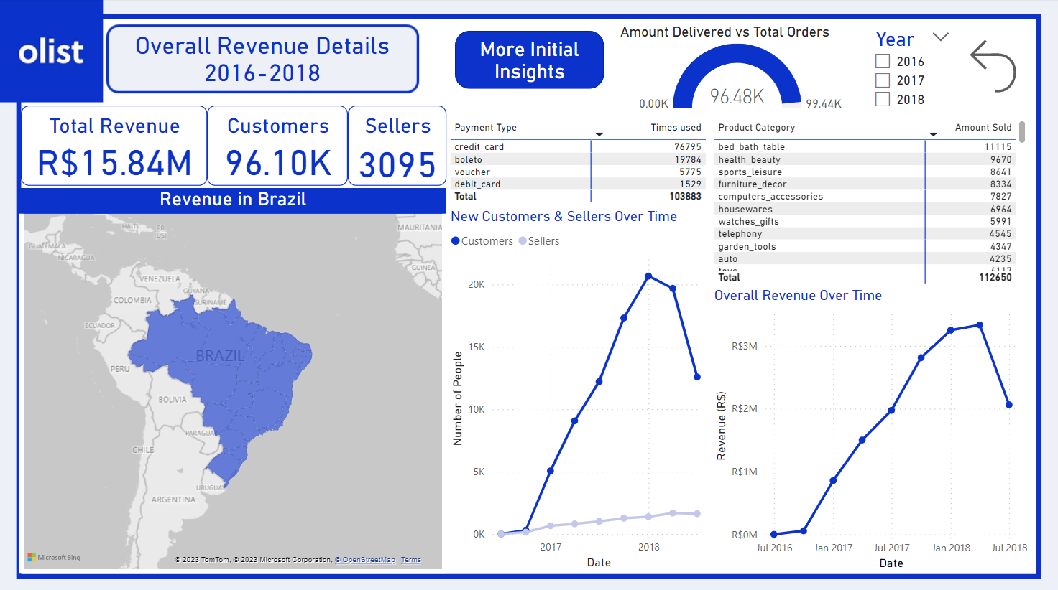
1.Overall Revenue
1.1
We can initially see that there’s an overall positive trend and that most orders were successfully delivered.
Most of the payments made were via credit card and the top 3 product categories are related to health/lifestyle

Slide 3
1.Overall Revenue

Slide 4
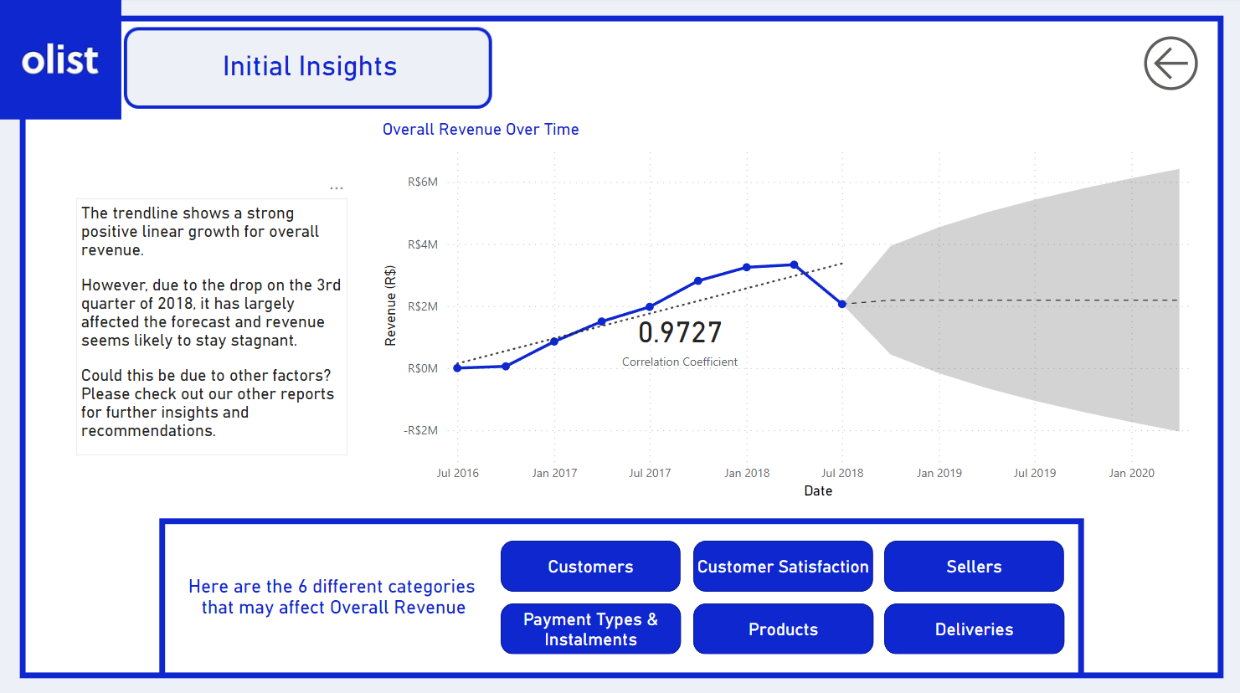
1.Overall Revenue
1.2 Shows initial insights in regards to overall revenue and if the user wanted more specific details, they can use the 6 buttons to open reports dedicated to each category

Slide 5
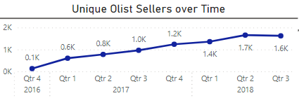
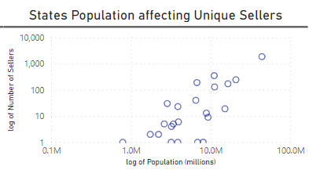
2. Sellers Report
2.1 Initial Findings
- Olist boasts 3,095 unique sellers, leading to the sales of 112,650 delivered goods totalling R$13.59 million since the final quarter of 2016
-The number of unique sellers working under the Olist brand has gradually risen over the years
-Sellers doubled from 600 at the start of 2017 to 1200 at the end of the year
-This was seen to be greater in the Brazilian areas with higher populations

Slide 6
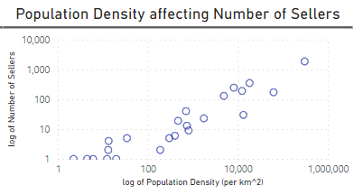
2. Sellers Report
2.1 Initial Findings continued
-We found that both population and population density of the Brazilian states had a strong positive correlation with increasing number of sellers -Note the x and y axis for both visuals use a logarithmic scale

Slide 7
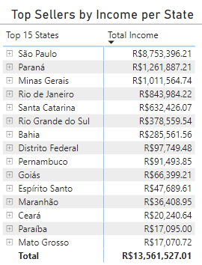
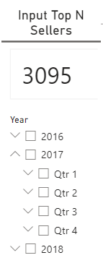
2. Sellers Report
2.2 Top Selling States
-The team investigating the sellers first decided to find out WHO were the leading sellers in terms of income made, before looking further into discovering WHY they have performed so greatly
-Using the filter on the top right, the user can limit the later results to find the top ‘N’ sellers, i.e inputting “10” gives you the top 10 sellers per state
-Users may also filter by yearly quarters if they wish

Slide 8
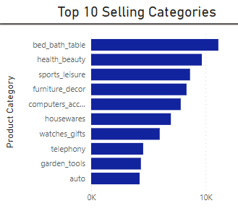
2. Sellers Report
2.3 What Products?
-Here we see the top 10 selling categories for the whole selling group, with ‘Bed, Baths and Tables’ category leading with 11,115 orders -‘Health and Beauty’ and ‘Sports Leisure’ following with 9670 and 8641 orders respectively to complete the top 3

Slide 9
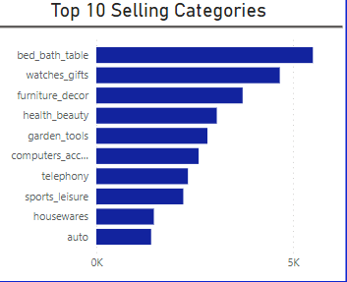
2. Sellers Report
2.3 What Products? Continued
-However, when we look at the top 10 sellers by income per state, we can see that ‘Watches and Gifts’ and ‘Furniture and Decoration’ jump into the top 3

Slide 10
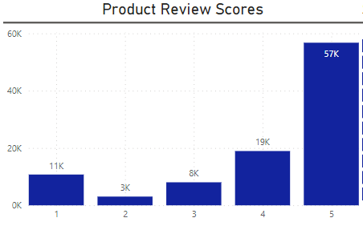
2. Sellers Report
2.4 Review Performances
-When looking at the feedback scores for all Olist sellers, we can see an overall positive score for all sellers on the goods sold Note, the scores are scaled 1-5, with 5 being a high positive score, and 1 being a low negative score

Slide 11
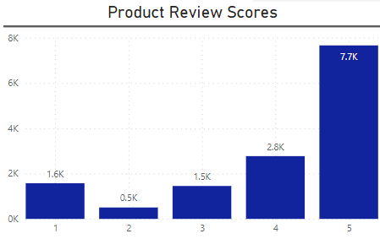
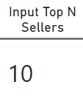
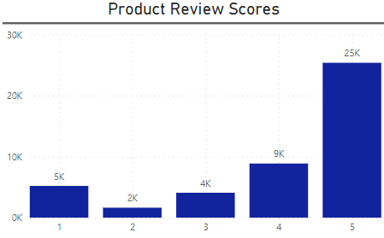
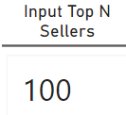
2. Sellers Report
2.4 Review Performances continued
-When reducing the sample size, the review scores results holds the same shape
-This tells us that the top sellers are satisfying customers to a similar rate than those throughout the Olist network
-Top 100 make up almost 50% of reviews, implying that lower sellers do not have dedicated customers returning review scores

Slide 12
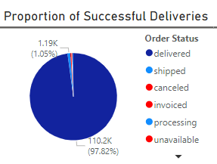
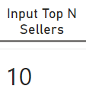
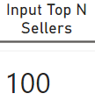
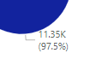
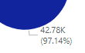
2. Sellers Report
2.5 Deliveries Outcomes
-When investigating delivery outcomes, we can see that for all sellers, Olist boasts a prominent 97.8% successful deliveries
-This figure falls to 97.5% and 97.1% for the top 10 and top 100 sellers respectively
-This tells us that fulfilled deliveries does not significantly impact the increase of future sales by Olist sellers

Slide 13

2. Sellers Report
2.6 Recommendations
-Firstly, distribution networks should be focused in areas of high populations and densities to match the high seller demands
-Secondly, home related goods such as beds, baths and furniture should be prioritised in sales, as they have the greatest performance by orders by all sellers
-The top 10 sellers are disproportionately successful in selling watches and gifts, and so ‘lower-level’ sellers may see greater success if these product types are incorporated into their sales
-Sellers with lower incomes need to build more engaged client base

Slide 14
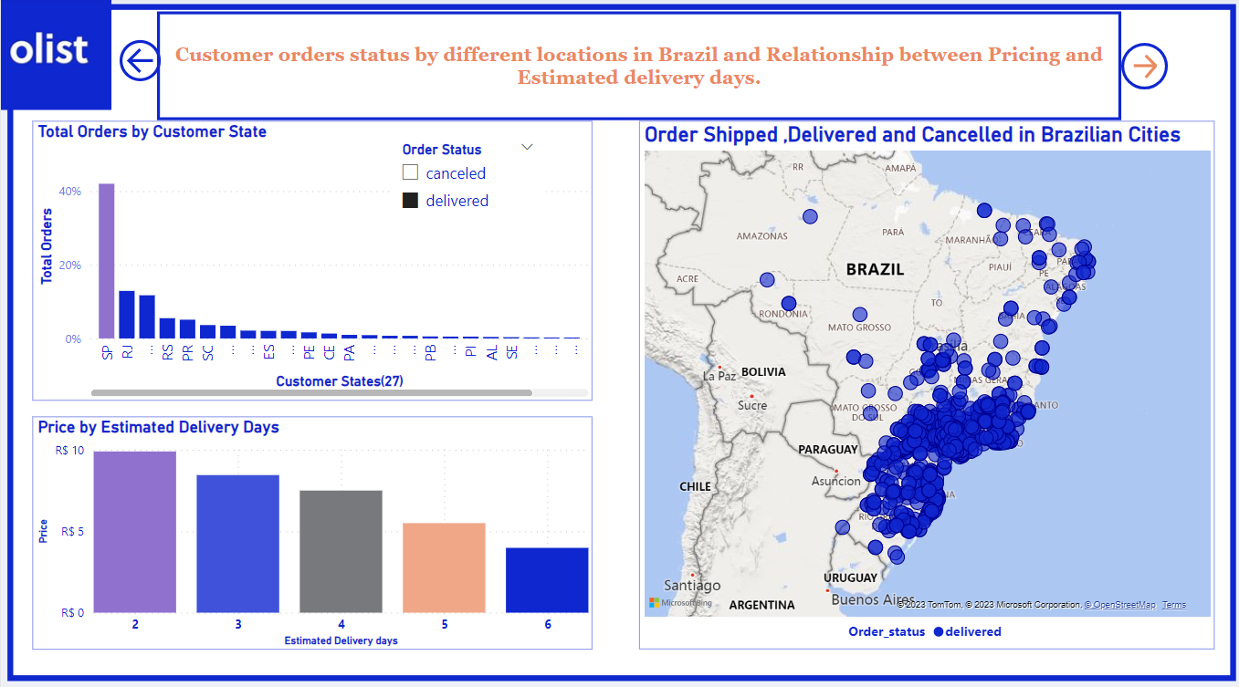
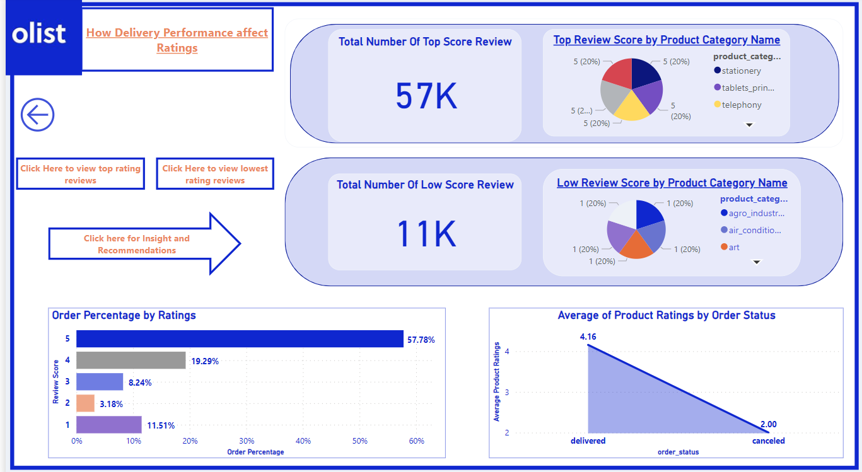
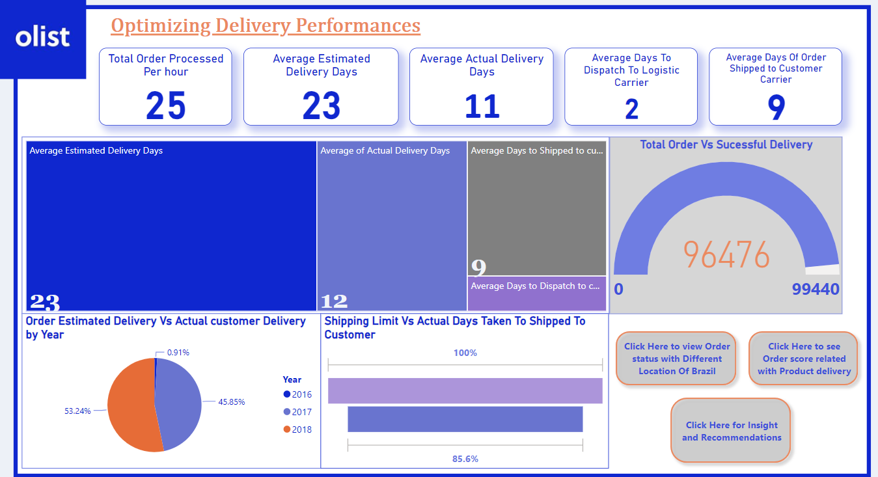
3.OPTIMIZING DELIVERY PERFORMANCE
1.Product review in terms of delivery
2.Order Percentage by Product review
1.Analysing Estimated Delivery Days vs Actual customer Delivery
2.Days taken to shipped customer vs l shipping limit.
1.Orders status vs Customer Location
2.Price vs Estimated time

Slide 15
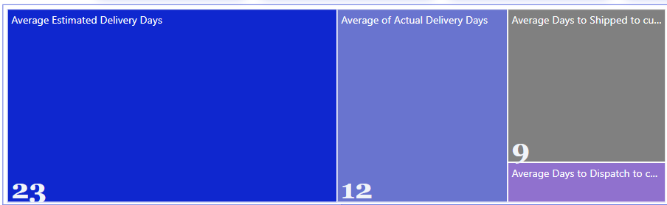
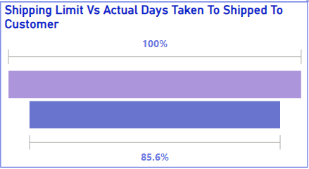
3.OPTIMIZING DELIVERY PERFORMANCE
Here actual Estimated delivery days to process an order is 23 and average delivery days taken to reach is 12 whereas Average days taken to dispatch to Logistic carrier is 2 days and average days taken to shipped from carrier is 9 days.
Here we can see the average shipping limit to dispatch the product and actual shipping days taken is 85 .6% which shows a faster dispatch rates to logistic carriers

Slide 16
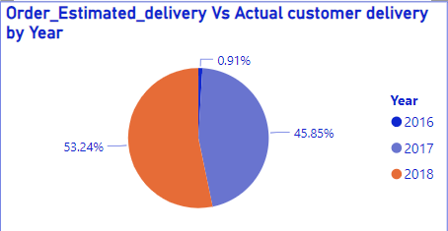
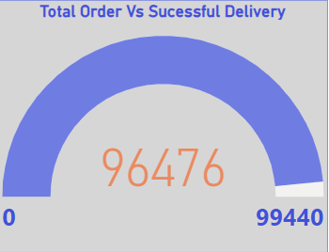
3.OPTIMIZING DELIVERY PERFORMANCE
1.Analysing Estimated Delivery Days vs Actual customer delivery:
Here we can see the it is increased by 53.24% since 2016 to 2018 so less delay in Product delivery
Total number of order is 99440, Succesful order deliveries is 96476

Slide 17
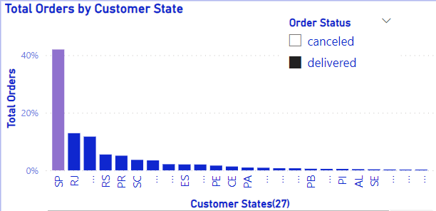
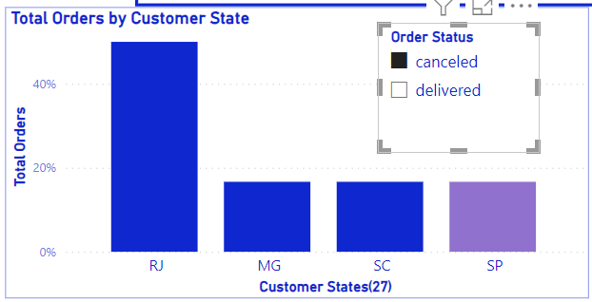
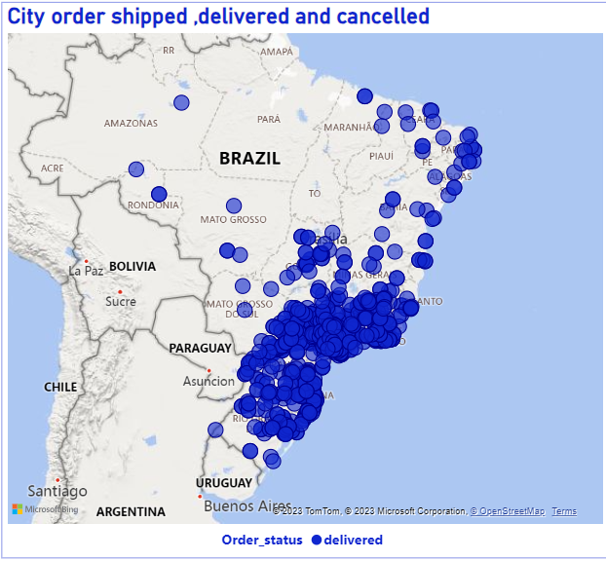
3.OPTIMIZING DELIVERY PERFORMANCE
Total orders by customer state in term of delivered ordered shows high concentrated(40%) of delivered ordered in Sao paulo state of brazil and Rio de janeiro being the most cancelled order state

Slide 18
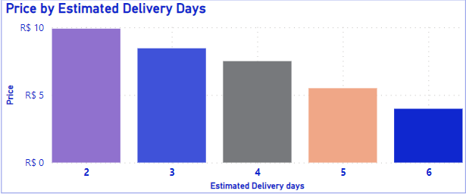
3.OPTIMIZING DELIVERY PERFORMANCE
When Total Price compared increases with Estimated Delivery days we see if estimated days are less than 7, then total price increases

Slide 19
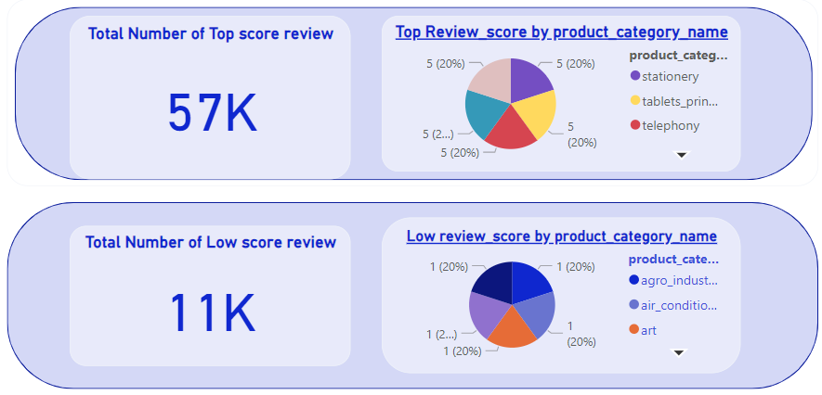
3.OPTIMIZING DELIVERY PERFORMANCE
Investigate product ratings and discover product categories that are prone to customer dissatisfaction and their satisfaction offered by olist ecommerce where total number of top rated scores are 57 k and total number of least rated scores is 11 k

Slide 20
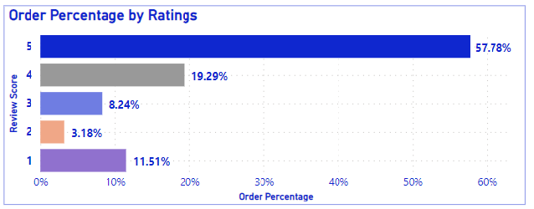
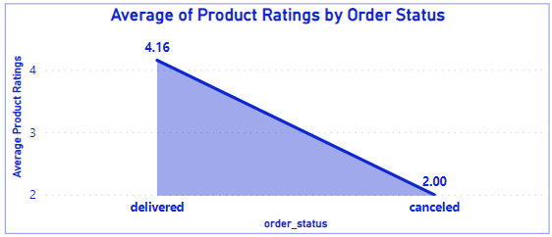
3.OPTIMIZING DELIVERY PERFORMANCE
This shows Order percentage in terms of scoring where most top 5 rating is 57.78 % and lowest rating is 11.51%
Here it shows Average Ratings by Order status which shows most delivered products was rated 4.16 whereas most cancel delivered scored 2.0 ratings

Slide 21
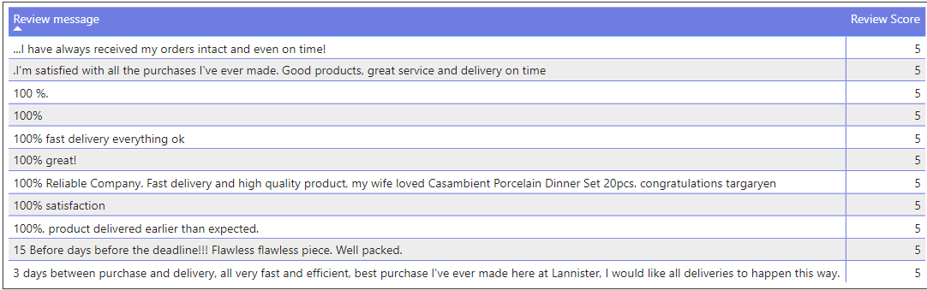
3.OPTIMIZING DELIVERY PERFORMANCE
Most top Product ratings depend upon faster delivery

Slide 22
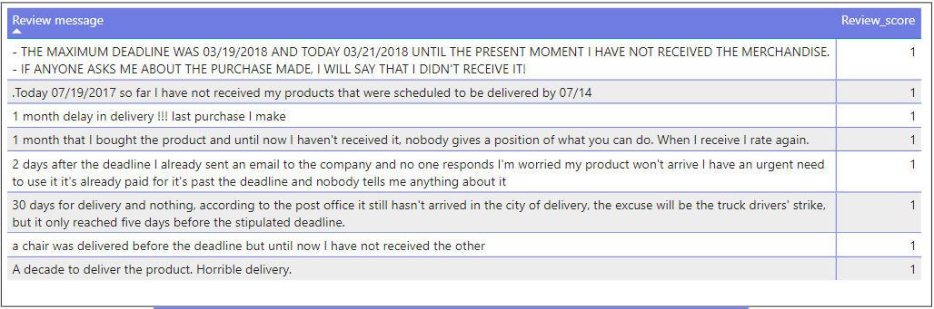
3.OPTIMIZING DELIVERY PERFORMANCE
Most low Product ratings depend upon delayed delivery

Slide 23
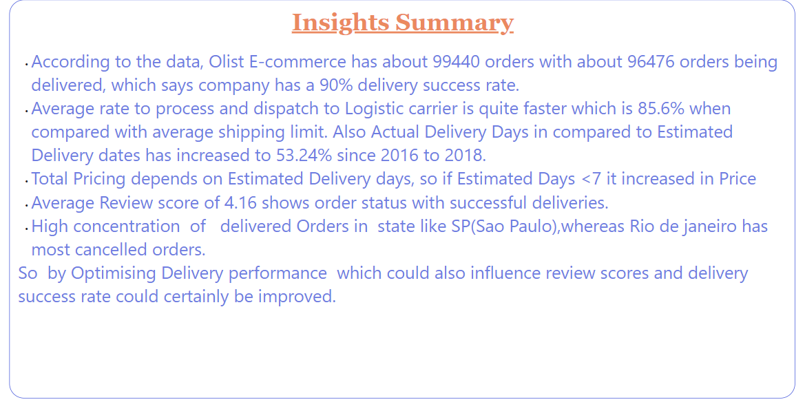

3.OPTIMIZING DELIVERY PERFORMANCE

Slide 24
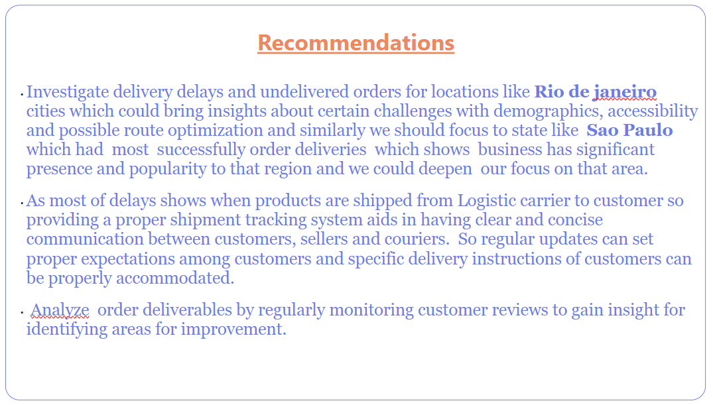

3.OPTIMIZING DELIVERY PERFORMANCE

Slide 25
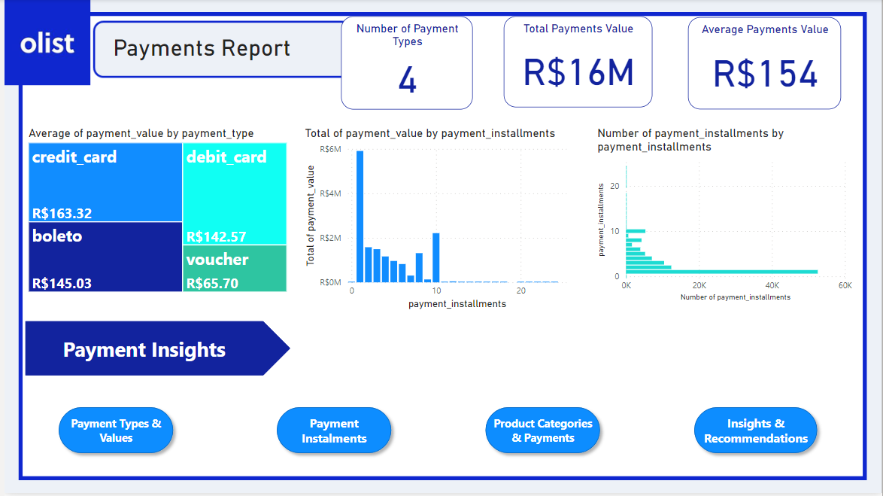
4. Payments Report

Slide 26
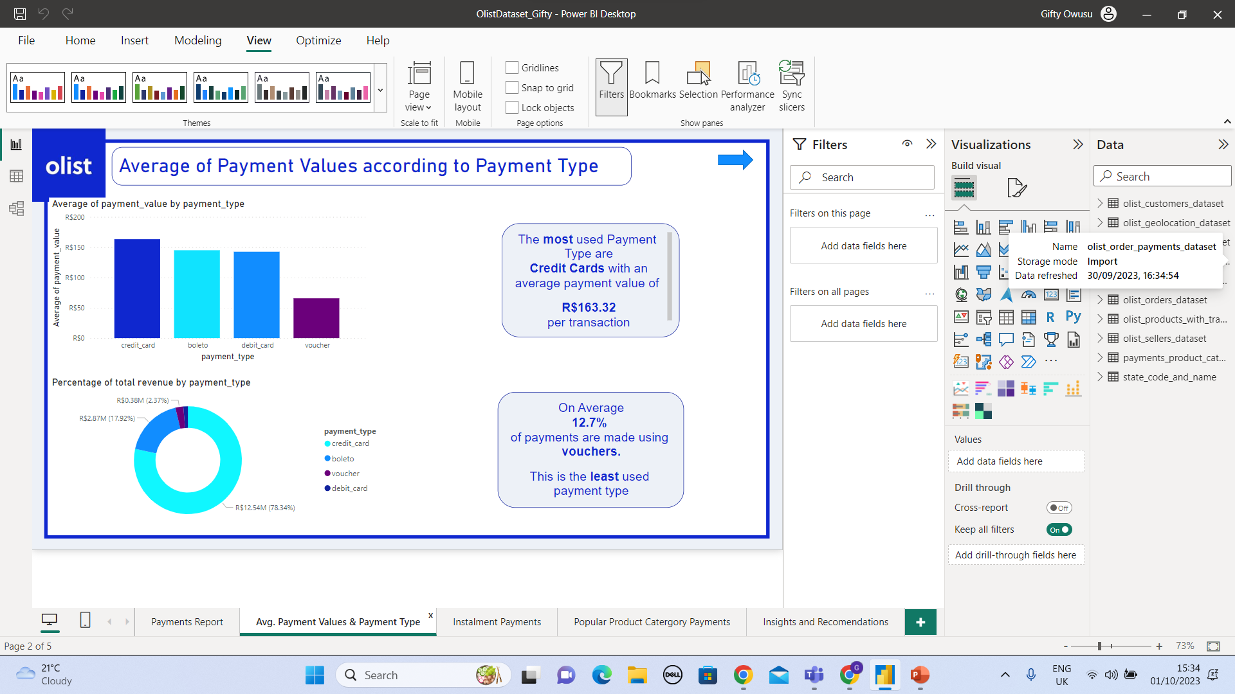
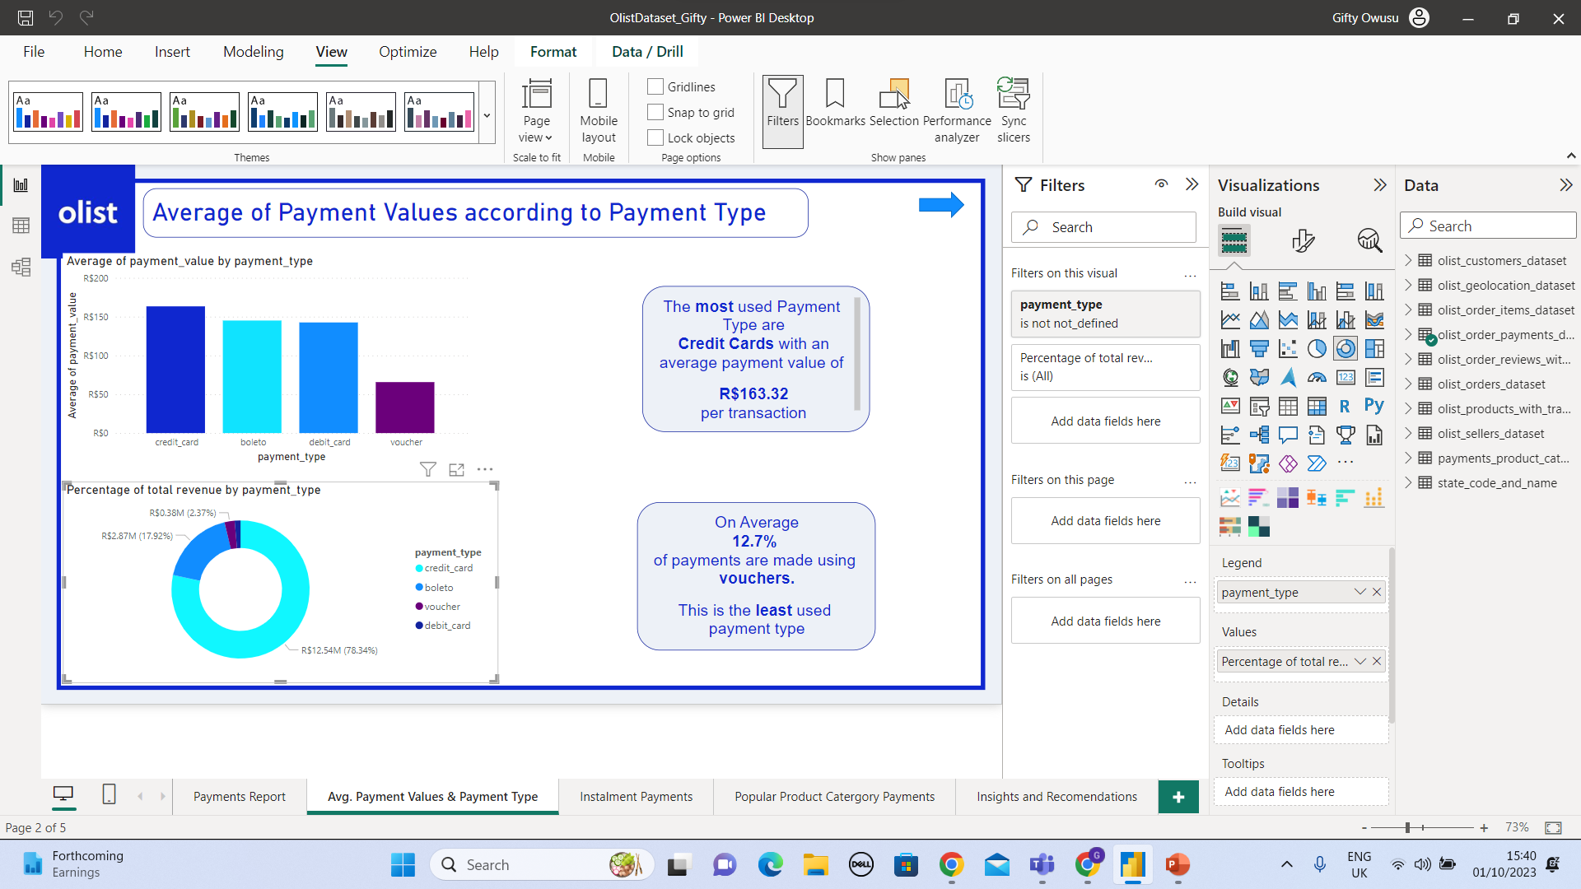
4. Average of Payment Values according to Payment Type
The most used payment type is a credit card. On average a value of R$163.32 is made per transaction
On average 12.7% of payments are made using vouchers. It is the least used payment type

Slide 27
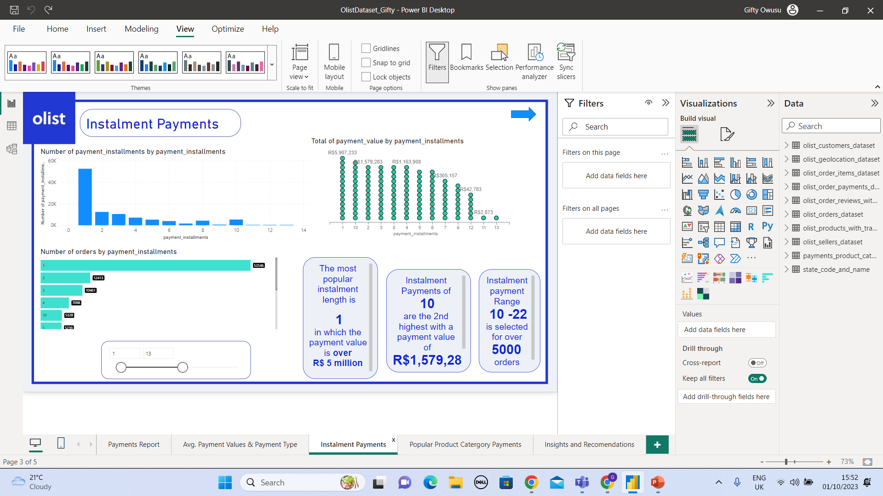
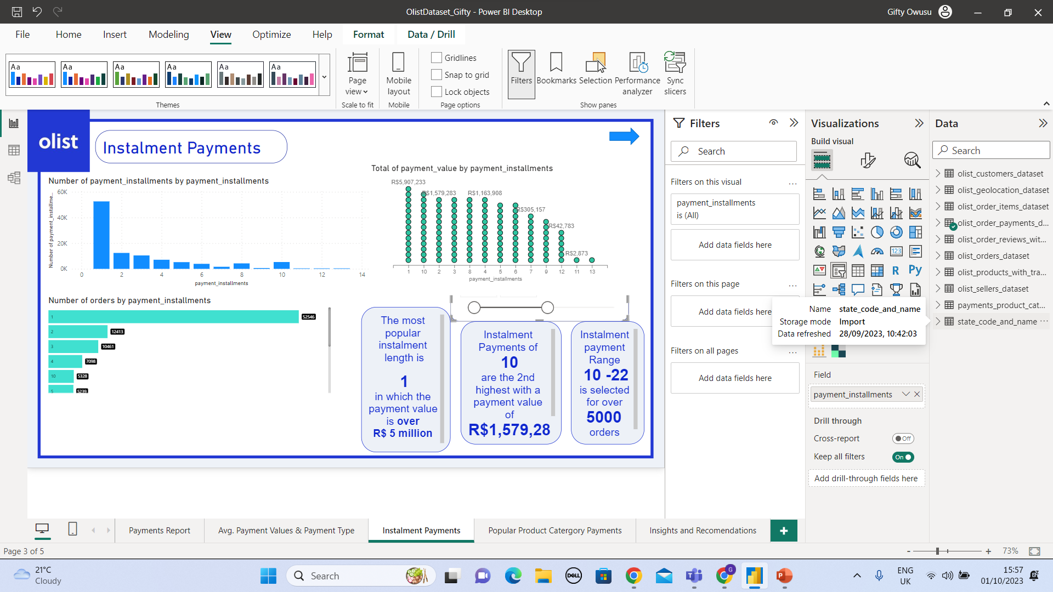
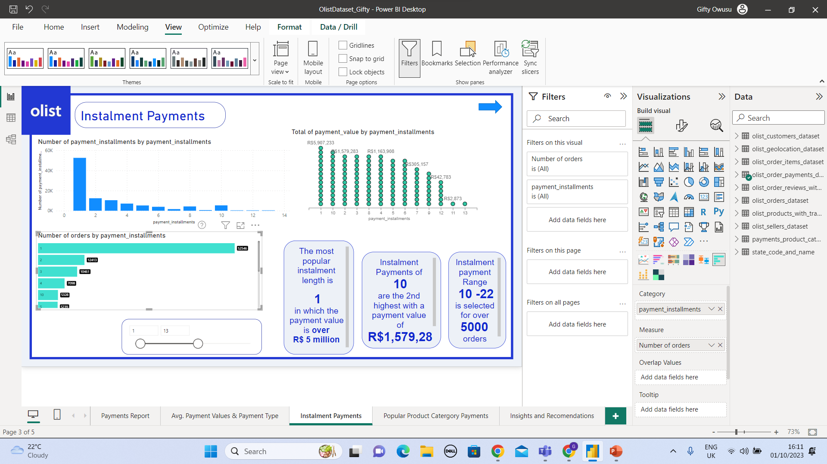
4. Payment Installments
The most popular payment instalment length is 1 with a payment value of over R$ 5 million
Instalment payments of 10 are the 2nd highest with a payment value of over R$ 2,000,000
Instalment Range 10-22 is selected for over 5000 orders

Slide 28
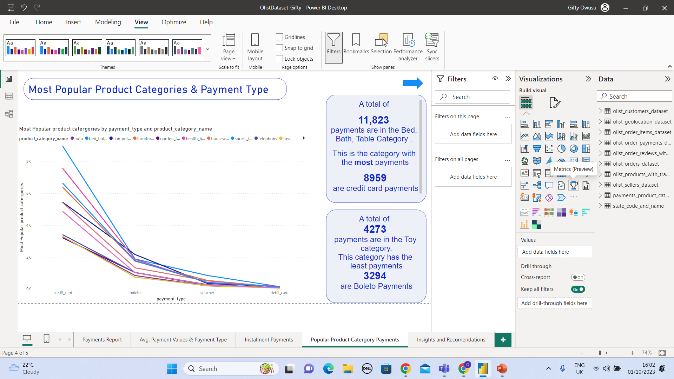
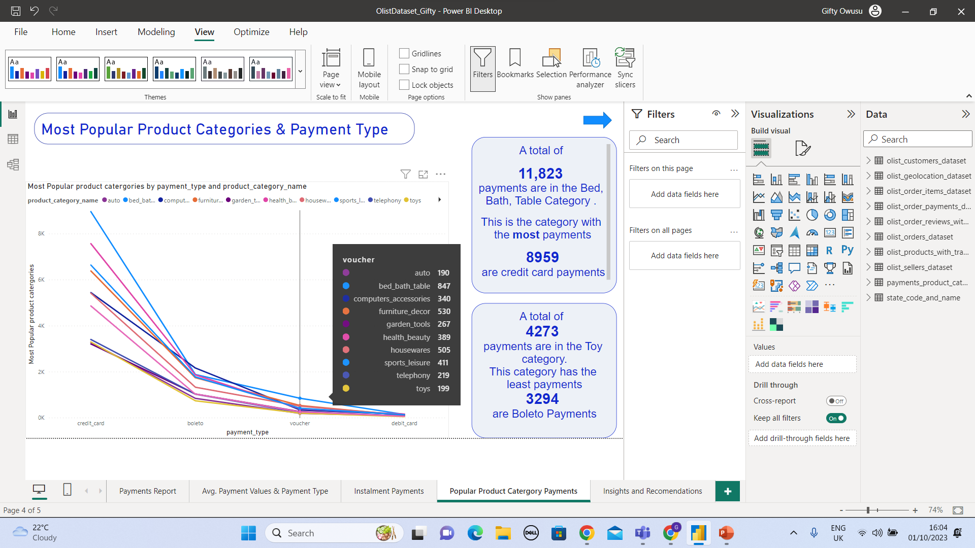
4. Most Popular Product Categories & Payment Type
A total of 11,823 payments are in the Bed, Bath, Table category.This is the category with the most payments. 8959 are credit card payments
A total of 4273 payments are in the Toy category. This category has the least payments. 3294 are Boleto Payments

Slide 29
4.Insights and Recommendations
Key Insights Summary for Payments
∙ Total Payment value for Olist is R$15.84 million
∙ The most used payment type are credit cards with an average payment value of R$163.32
∙ On average 12.7% of payments are made using vouchers. This is the least used payment type.
∙ The most popular instalment length is 1 in which the payment length is over 5 million.
∙ Instalment payments of 10 are the second highest with a payment value of R$1,579,28
∙ The Instalment payment range 10 is selected for over £5000 orders
∙ A total of 11,823 payments are in the Bed, Bath, Table category. This is the category with the most payments. 8959 of those payments are credit card payments
∙ A total of 4273 payments are in the Toy category. This is the category with the least payments. 3294 of those are Boleto payments.
Recommendations for Payments
Vouchers are offered as a payment option by this company, but it is the least used payment method. It may be good for the marketing department to find ways to promote the use of vouchers amongst customers. An increase in the sale and use of gift vouchers could potentially bring in new customers and increase sales.
By looking at the instalments we can see that a substantial amount of instalments are more than 6 with 10 being quite a popular option with your customers. It is advised that the company looks into ways that to shorten the length of the instalment payment period. It is a possibility that If your customers pay off their debt earlier, they may be more able/willing to make another purchase from your company.
When looking at payments amongst the various product categories it was evident that there were considerably more payments made to some categories than to others. Focusing promotion in the categories where customers have made a lot of payments has the possibility of boosting sales. Also, it is recommended that within product categories where payments are not particularly high, Otis should try and find ways in which customers will become more attracted to purchasing those products. This could help to increase the number of payments and sales within those product categories.
Other areas which would benefit from further analysis would be to take a deeper look into your part payment options and also conduct research to see how beneficial it may be to the company and customers if more payment options were made available in the future.

Slide 30
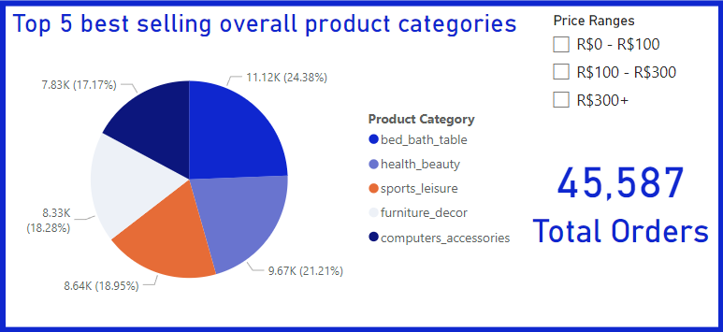
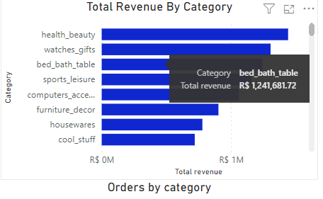
5.Product Performance
Best Selling?
Best selling category overall in terms of orders is bed, bath and table accounting for approximately 10% of total orders and R$1.24M revenue.

Slide 31
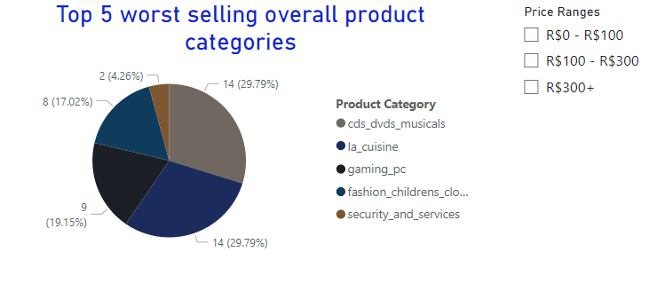
Worst Selling?
Worst selling category overall is security and services with just 2 orders which could suggest people do not trust buying security equipment from third party sellers

Slide 32
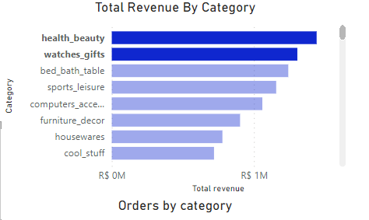
Total Revenue?
watches gifts and health beauty are both categories that have the highest two revenues streams accounting for R$ 2,746,789.68 of total revenue suggesting this is a place where people buy gifts for others as these two categories are usually gifts

Slide 33
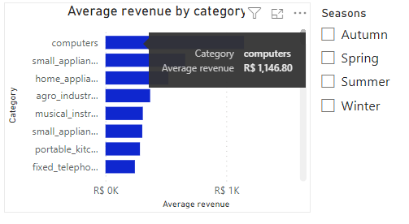


Average Revenue?
Computers have the highest average revenue of products, however during spring and winter this revenue falls below R$1000 suggesting average order revenue reduces over these seasons

Slide 34


Shipping Costs?
Figure 1
Figure 2
Shipping costs shows that the higher cost of shipping categories (top 3) do not place in the top 5 total revenue (Figure 1) which suggests people are put off by high shipping costs.
Three of the top 5 revenue categories have shipping around R$18 (Figure 2)

Slide 35

Product Size?
Majority of orders tend to have boxes with a small surface area (0-150cm^2) suggesting that the majority of goods bought are small

Slide 36


Product Listings?
Long title lengths (50+ characters) tend to have higher orders than smaller titles suggesting a positive correlation with title length and orders
Products with 1 photo advertised have the most orders and as quantity of photos rise there are less orders, suggesting 1 photo is enough to get orders

Slide 37
Recommendations
Sellers could opt to selling more premium watches and health products as these two have the highest revenues and have the highest orders for premium priced goods ($300+)
Total revenue falls during autumn and winter thus adding more promotions or more marketing during these seasons could allow for more sales revenue during these times
Sellers would benefit from setting longer title lengths as there is a positive relationship between title length and orders thus recommended to use longer titles as well as have around 1-2 good quality photos to maximise their orders
'Computers' average revenue falls below R$1000 during spring and winter thus advertisements for computers during these seasons are recommended to increase to keep the average revenue above R$1000 for all seasons
Better relations with shipping suppliers could mean more revenue streams open up since revenue is not high for the top 5 highest shipping costs product categories. Around R$18 suggests that people are still willing to pay that since 3 of the top 5 categories by revenue have that

Slide 38

6. Customers
6.1
Shape of visualisations are very similar, implying that revenue may be dependent of new customers

Slide 39



6. Customers
6.2
The top 5 states with the most customers are the reason why the sellers are drastically outnumbered, affecting the visual

Slide 40

6. Customers
6.3
Most customers and sellers seem to be concentrated at and around the area of the state of São Paulo

Slide 41


6. Customers

Slide 42

7. Customer’s Satisfaction

Slide 43

7. Customer’s Satisfaction

Slide 44

Dashboard

Slide 45

Dashboard

Slide 46
Any Questions?

